Slide 1
Introduction to
Envo Scholar v 1.0
Senior Project Fall 2018
Team Members: Bryan Bastida and Andrew Castillo
Product Owner: Mark Finlayson
Instructor: Masoud Sadjadi

Slide 2
Problem
Today, semantic search is a newer concept seeking to understand user’s intents by adjusting searches based on the contextual meaning of words and terms. With the rise of websites such as Semantic Scholar, the surface of semantic search is being broken. Currently there is no platform to search via a semantic search for environmental scientific articles.

Slide 3
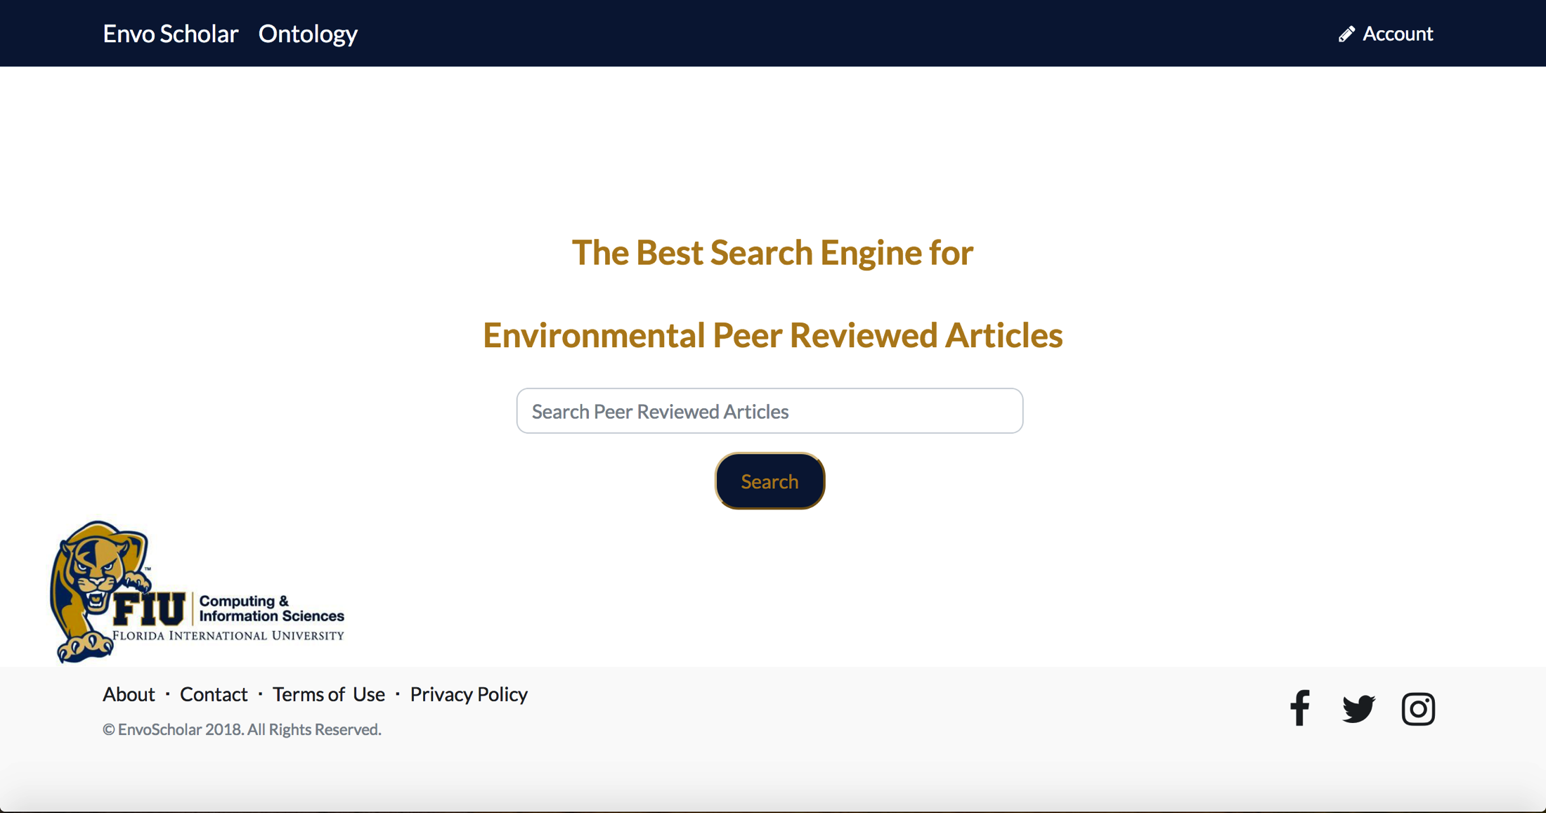
Project Definition
Users can enter a search query to being searching for articles.

Slide 4
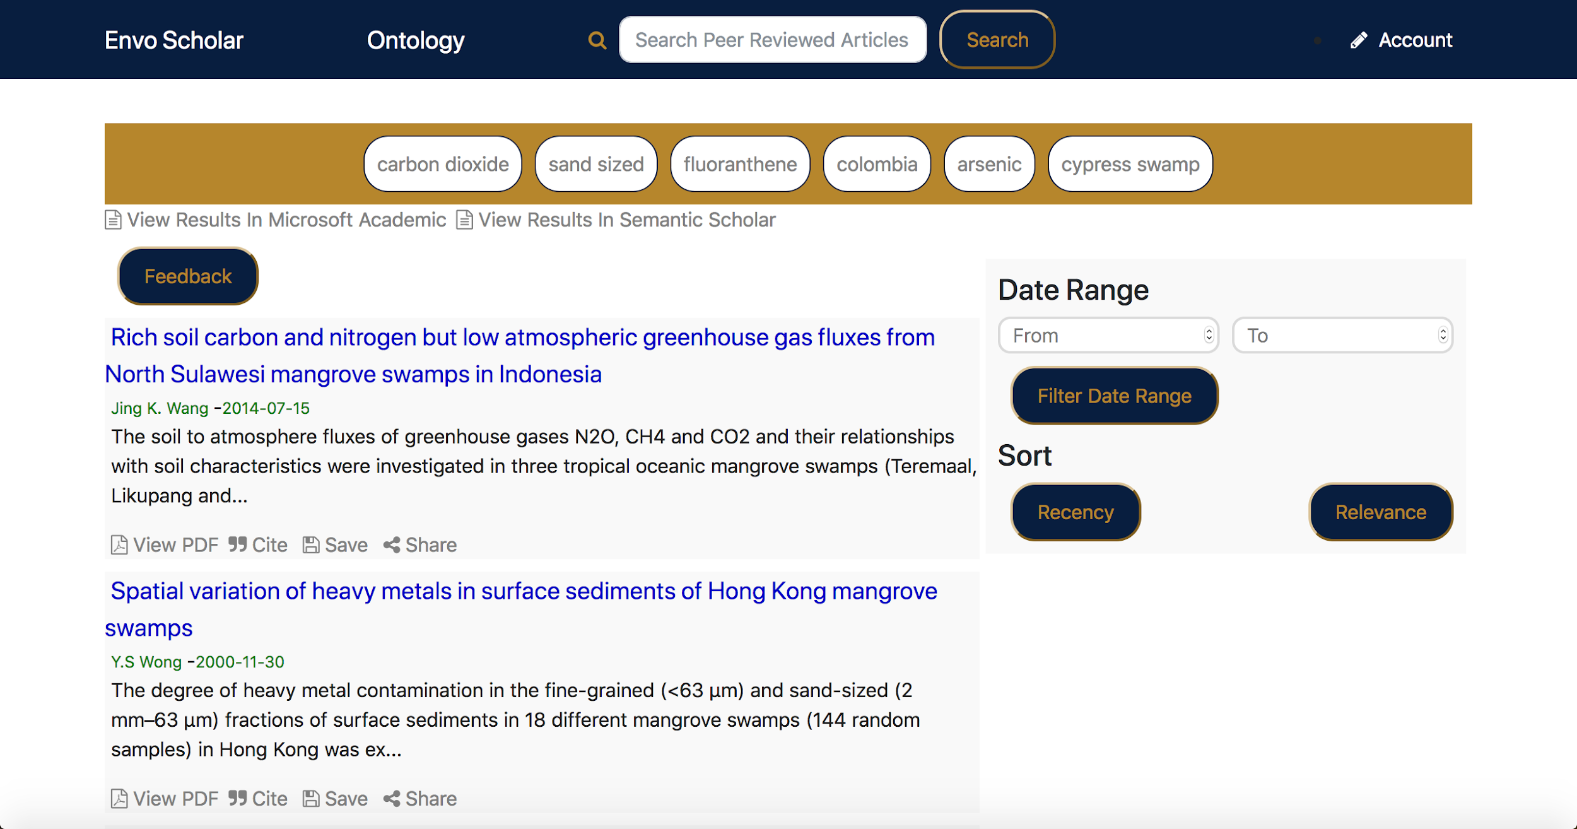
Project Definition
Displaying results for the search query ‘swamps’.

Slide 5
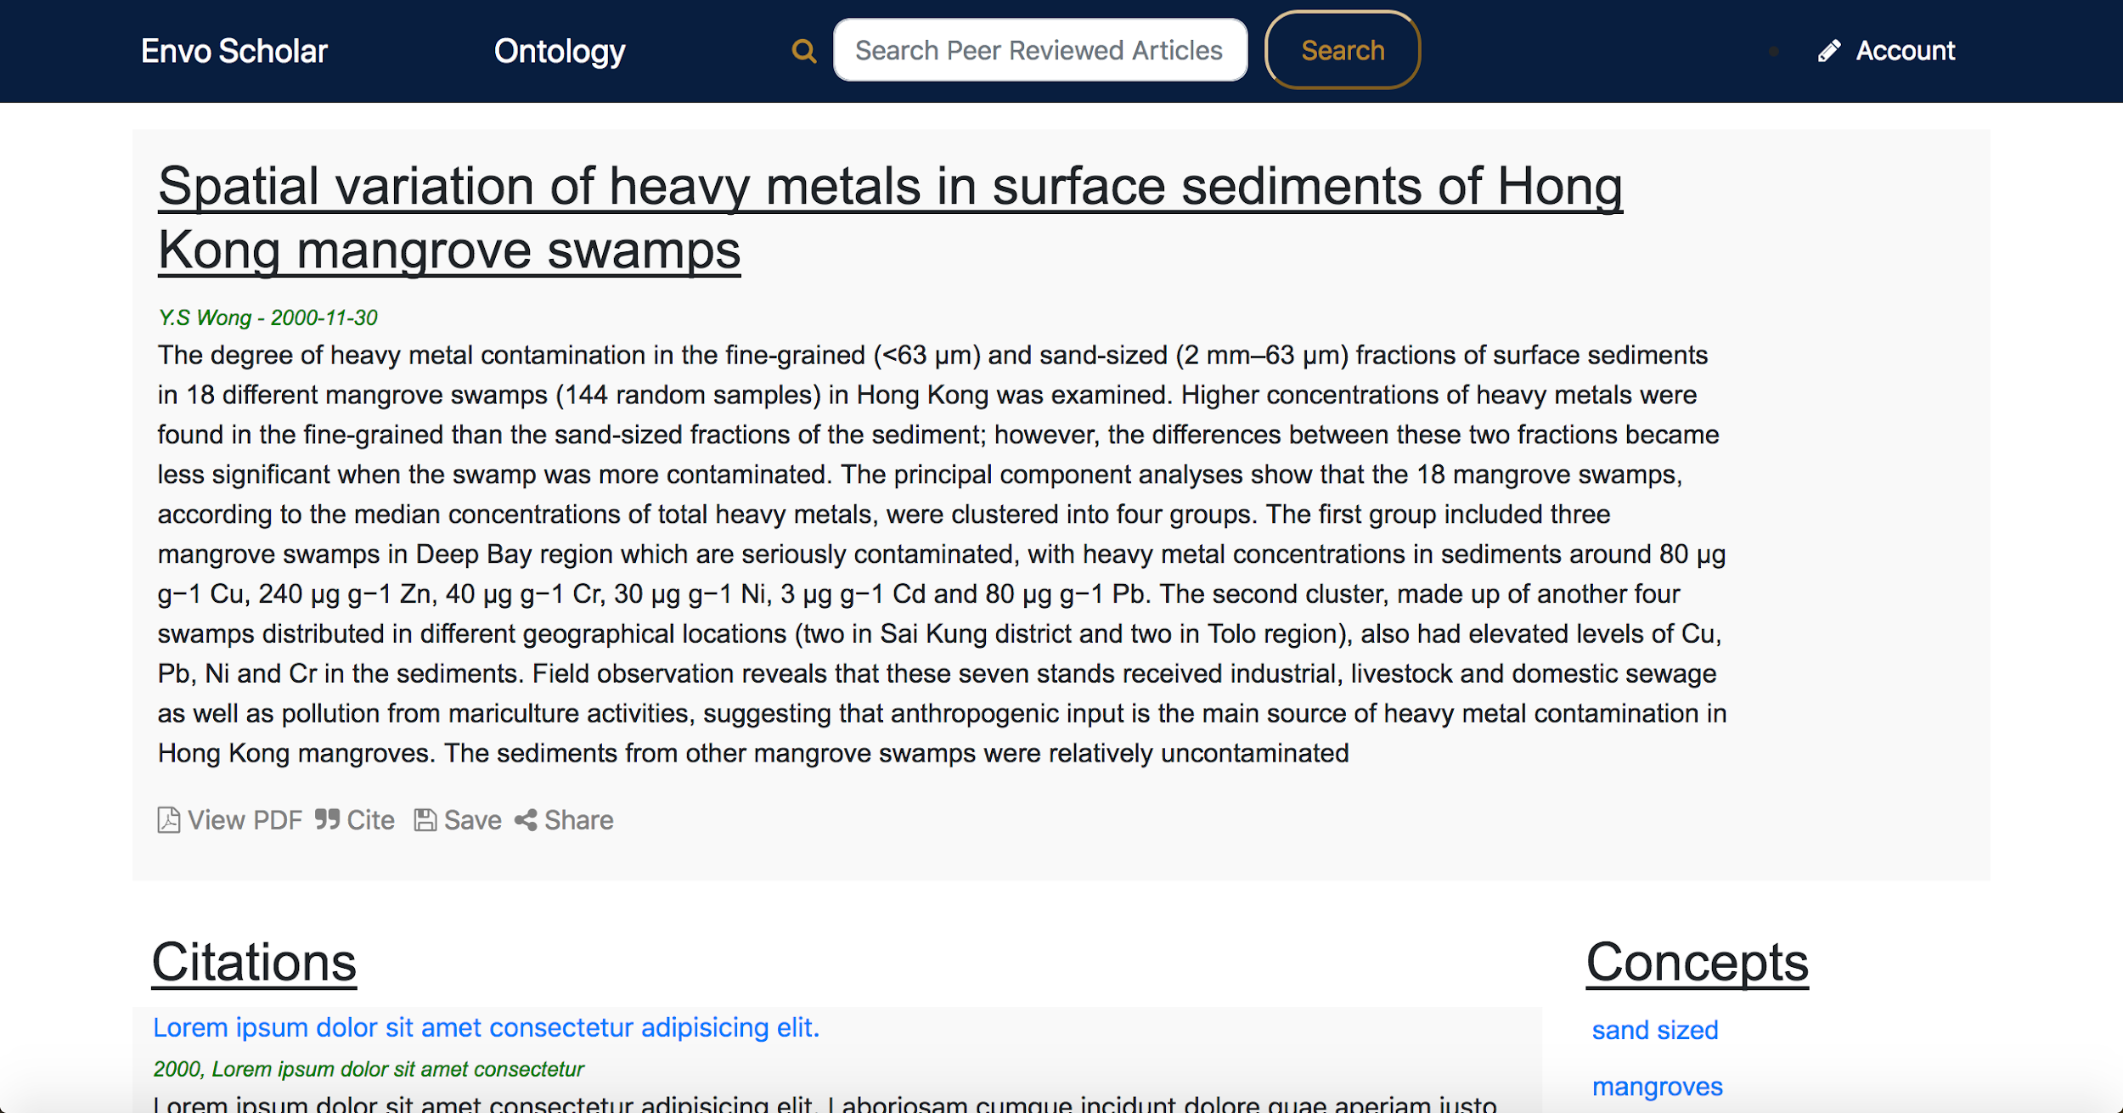
Project Definition
Article information on the article that was clicked on.

Slide 6
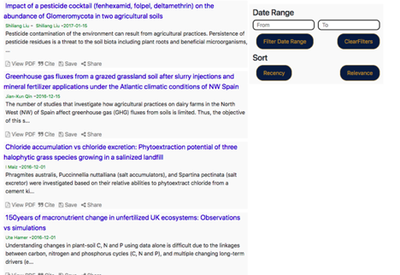
Project Definition
Sort Results for search query ‘grass’.

Slide 7
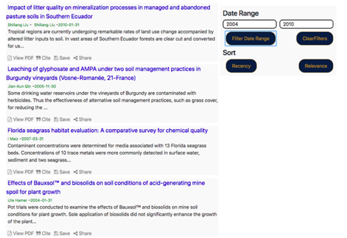
Project Definition
Filter Results for search query ‘grass’.

Slide 8
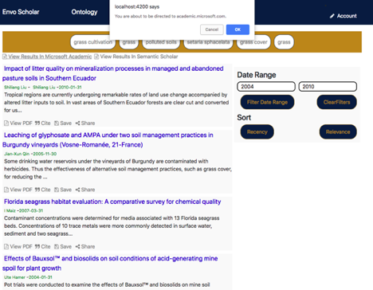
Project Definition
Cross compare with Microsoft Academic.

Slide 9
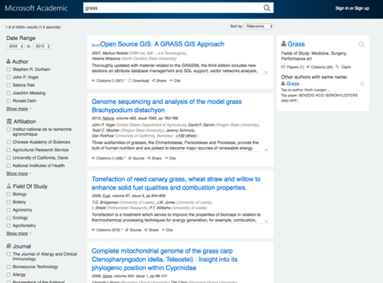
Project Definition
Navigation to Microsoft Academic with filter.

Slide 10
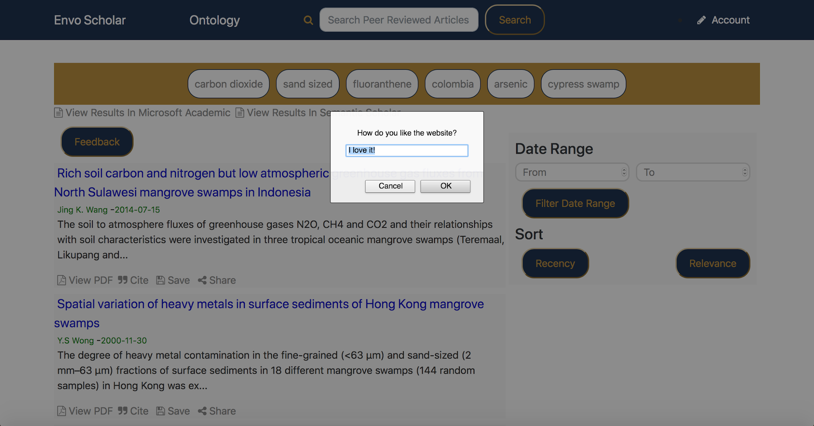
Project Definition
User prompted to give feedback on the website.

Slide 11
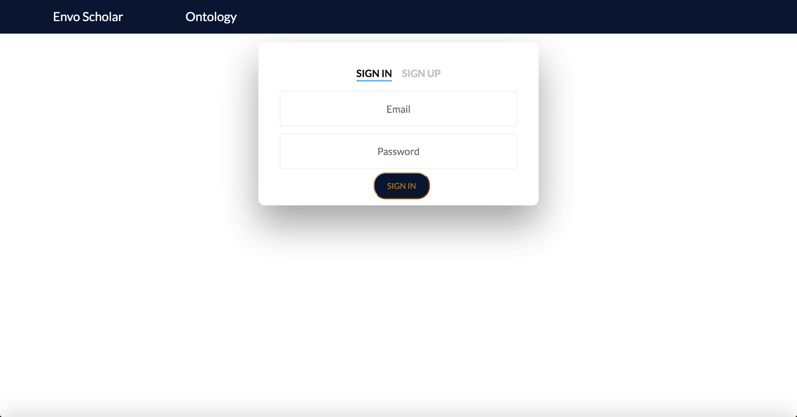
Project Definition
User Sign In page

Slide 12
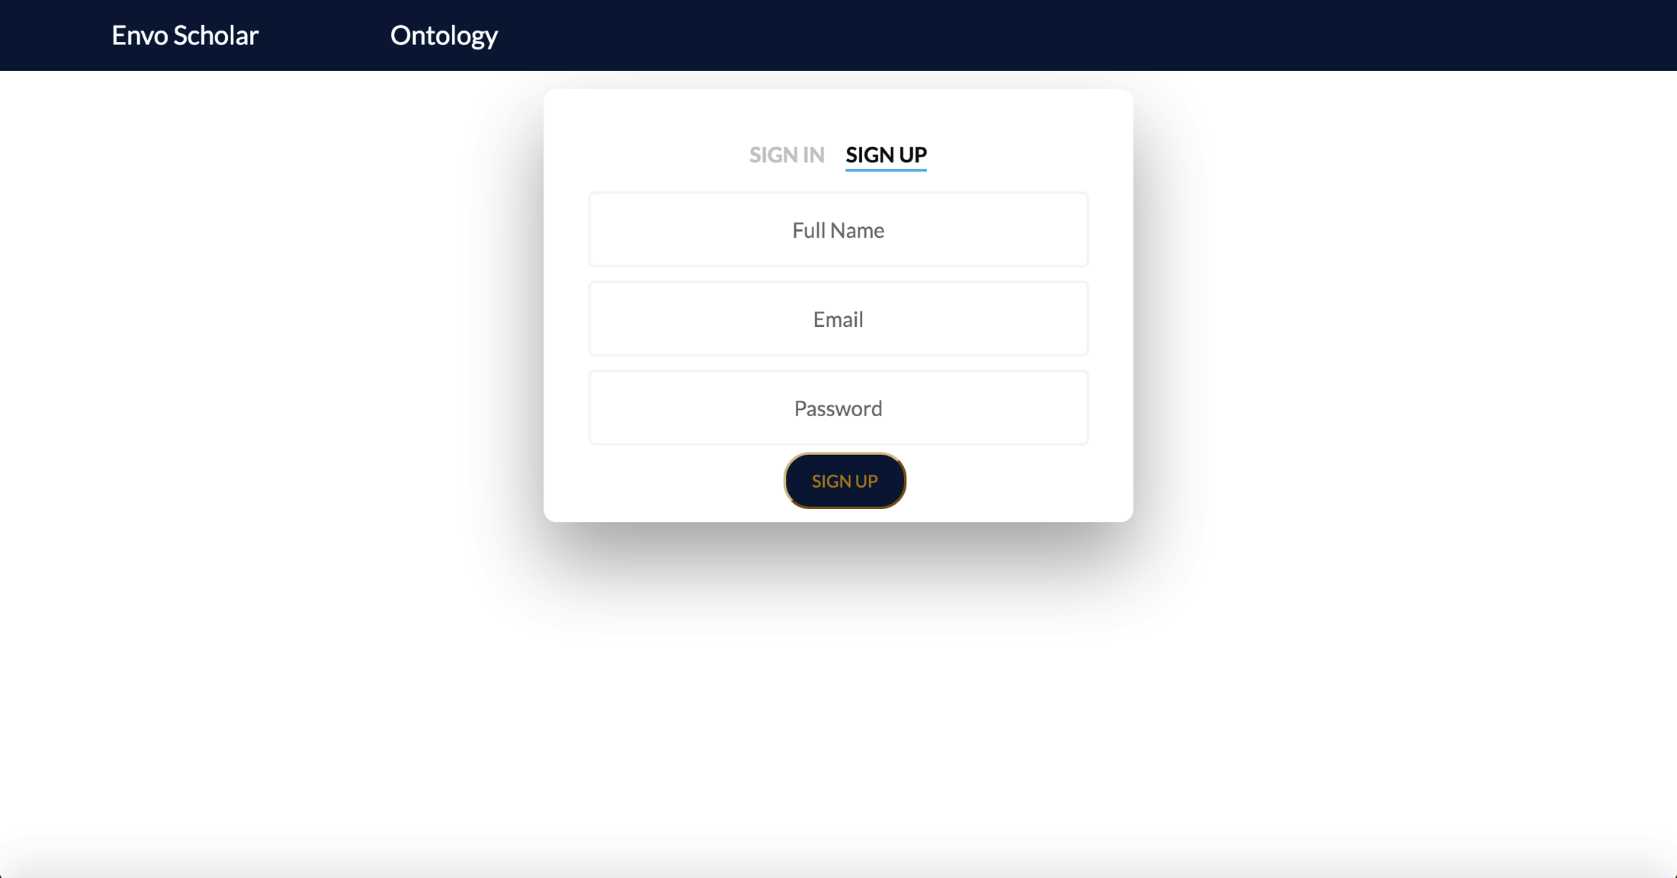
Project Definition
User Sign Up page

Slide 13
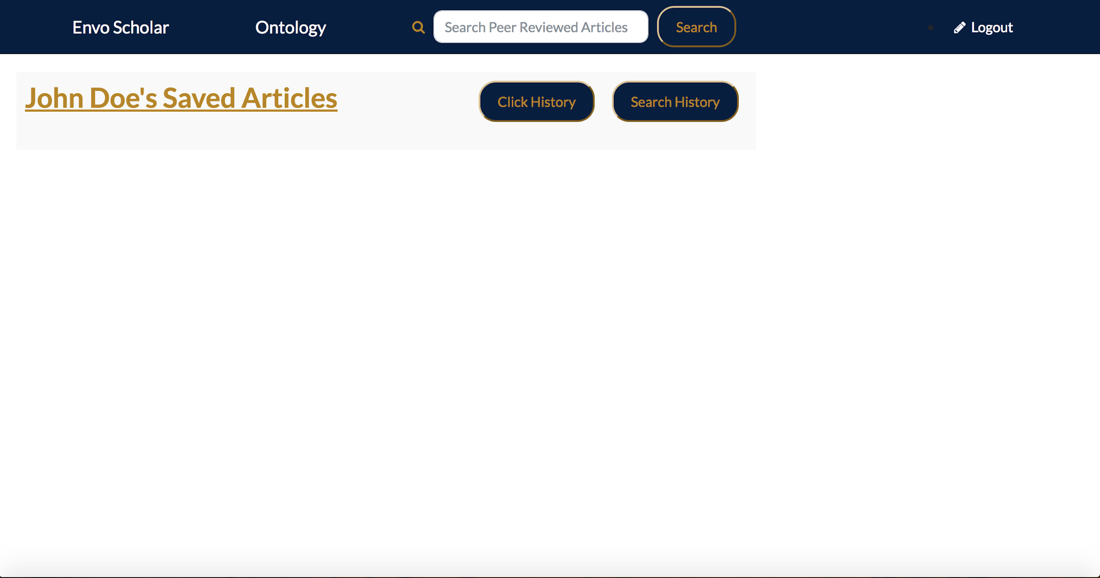
Project Definition
Users brand new Profile/Saved Articles page (will start empty)

Slide 14
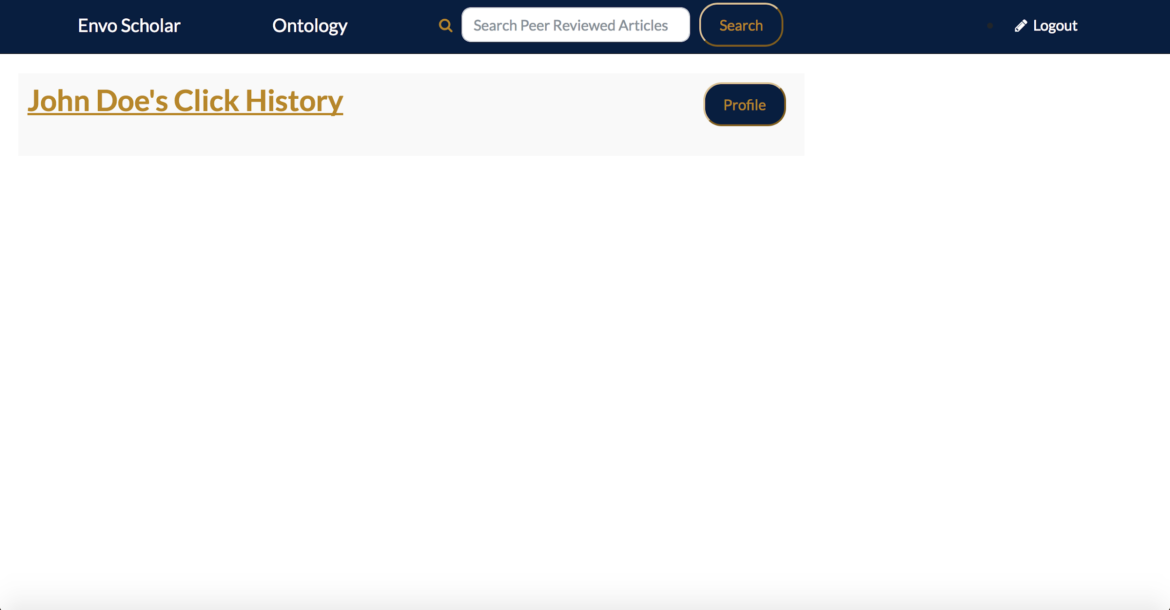
Project Definition
Users Click History Page (will start empty)

Slide 15

Project Definition
Users Search History page (will start empty)

Slide 16
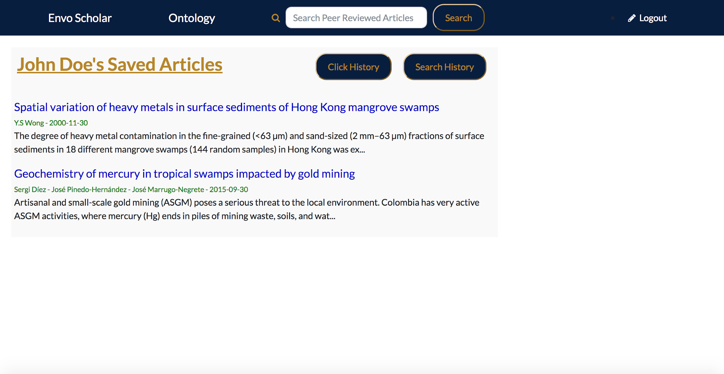
Project Definition
Users Profile/Saved Articles page once the user has saved at least 1 article

Slide 17
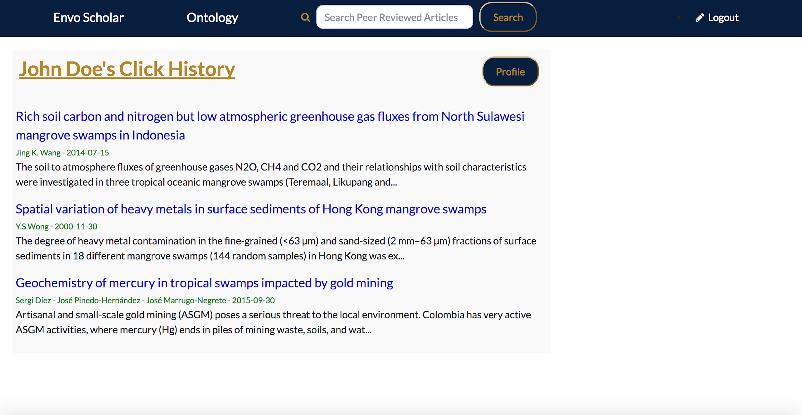
Project Definition
Users Click History page once the user has clicked on at least 1 article

Slide 18
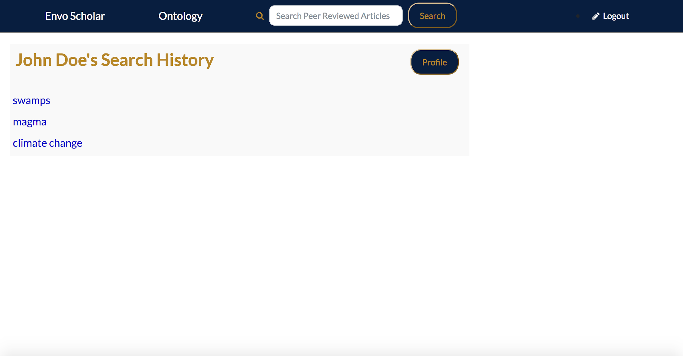
Project Definition
Users Search History page once the user has entered at least 1 search query.

Slide 19
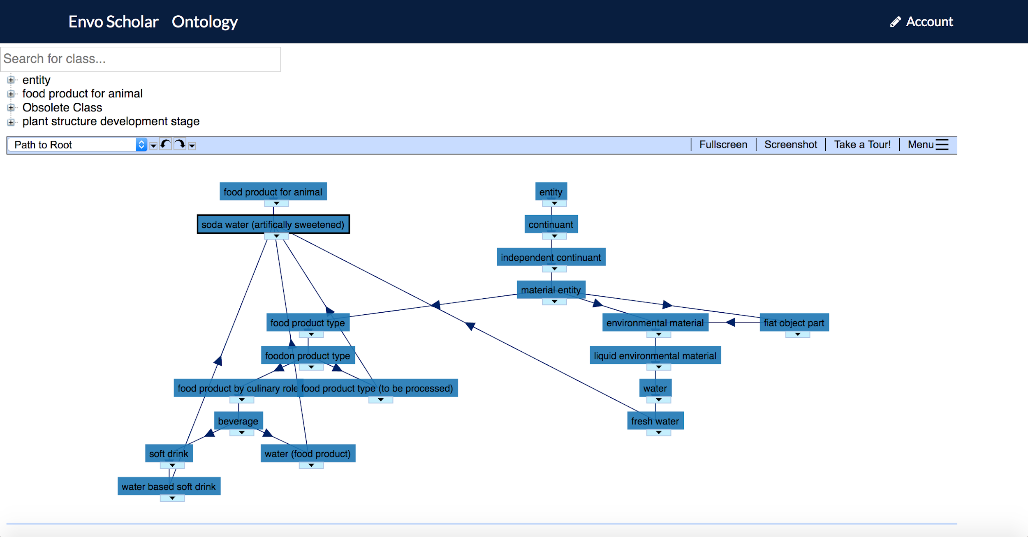
Project Definition
Ontology Search and Interactive Tree

Slide 20
Summary
In EnvoScholar 1.0 my partner and I successfully
implemented basic functionality creation of a
personalized profile, searching, manipulating results
and providing the users with the most desired articles.
Version 1.0 is just the beginning for EnvoScholar, my
partner and I came from knowing very little web
development and project management to absolutely
thriving in both fields with true passion. EnvoScholar
has a long way to go but we believe a successful project
always starts with a great foundation.

